Slide 1
Automatic Text Summarization

Slide 2
What is Automatic Text Summarization
Methods
Evaluation

Slide 3
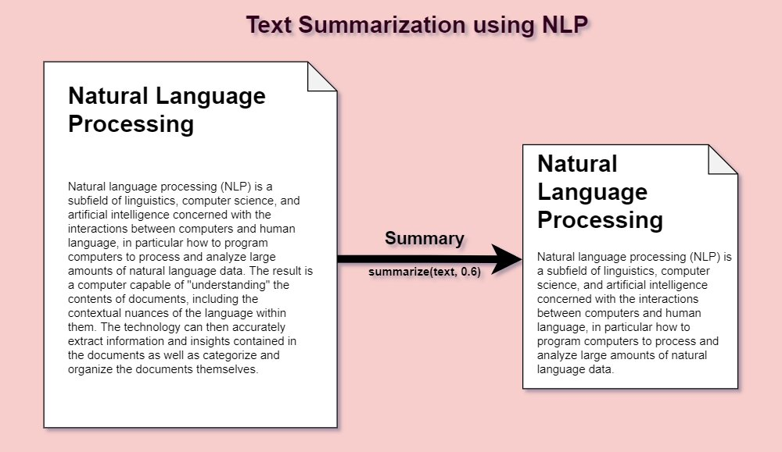
What is Automatic Text Summarization?
Automatic summarization is the process of shortening a set of data computationally, to create a subset (a summary) that represents the most important or relevant information within the original content. (Wikipedia)

Slide 4
Why Summary?
Less Time
More Text Data
Why Difficult?
Selecting the most relevant information from a source document
Expressing that key information in the final summary
Objective
How can you identify the most important thing in the shortest amount of time
Optimize information coverage
Optimize readability

Slide 5
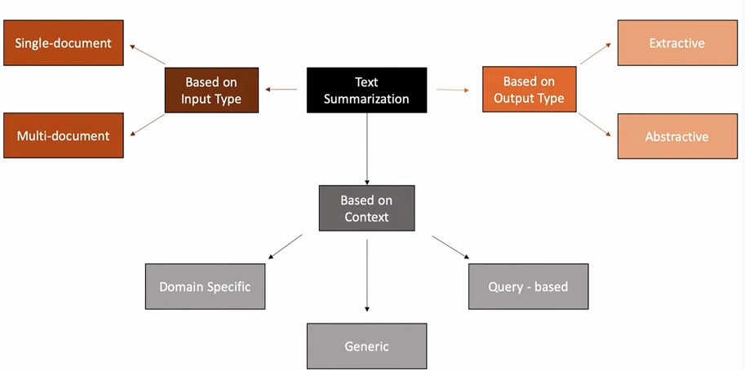
Type of text summarization

Slide 6
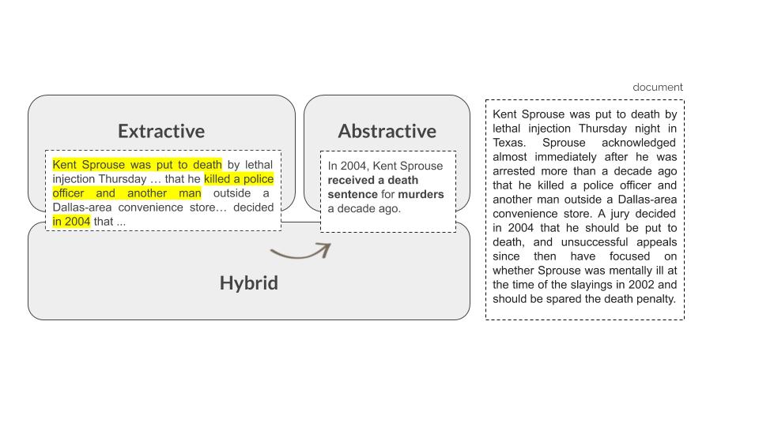
Extractive vs Abstractive Summarization
Extractive
Abstractive

Slide 7
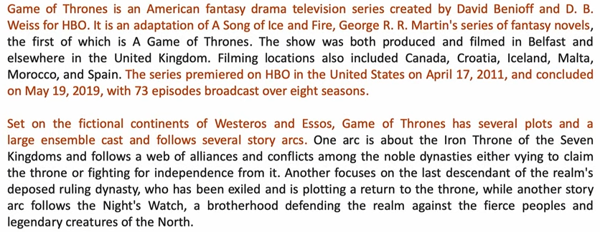
Extractive Summarization
Advantage: Grammatical correctness

Slide 8
Extractive Summarization-Lack of Balance

Slide 9
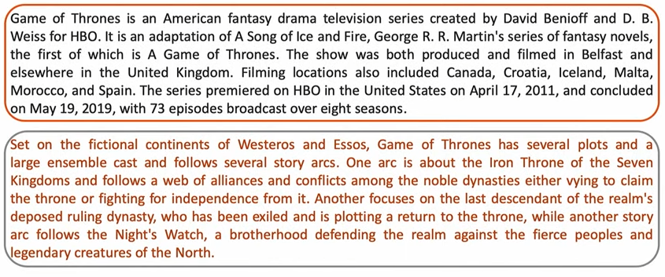
Extractive Summarization-Lack of Balance

Slide 10
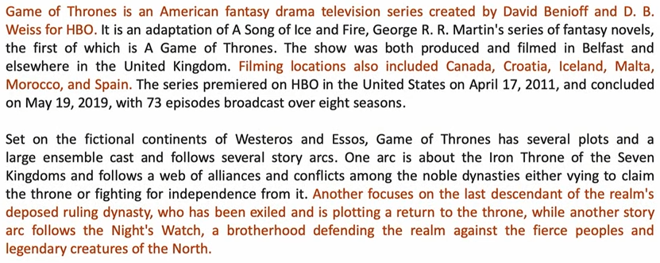
Extractive Summarization-Lack of Cohesion

Slide 11
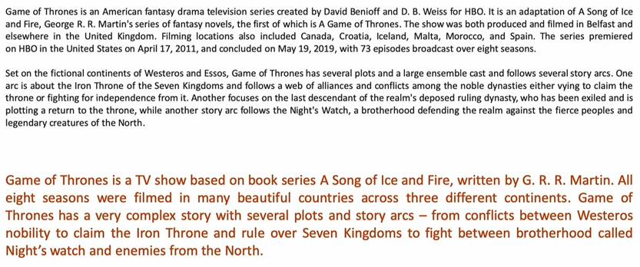
Abstractive Summarization

Slide 12
What is Automatic Text Summarization
Methods
Evaluation

Slide 13
Positional Method (Baxendale, 1958)
Technical literature
Analysis on 200 paragraphs
First and last sentence of a paragraph are topic sentences (85% and 7%)

Slide 14
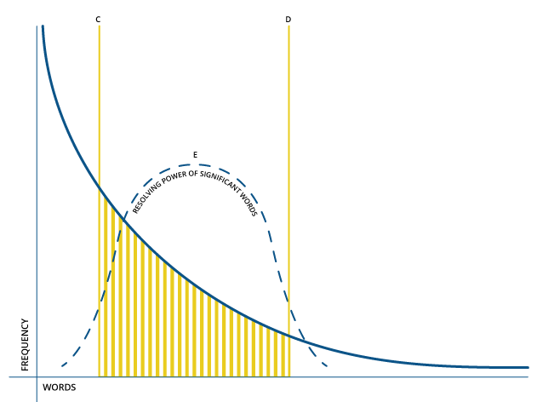
Luhl’s Method, 1958
Extract salient sentences from the text using features such as word and phrase frequency.
Weight the sentences of a document as a function of high frequency words, ignoring very high frequency common words.

Slide 15
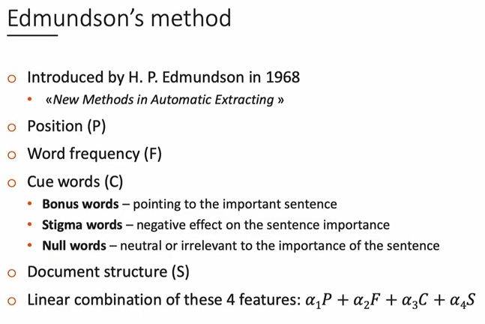

Slide 16
Other methods
Topic representations
Word Probability
TF-IDF
Topic word Approaches
Machine-Learning Methods

Slide 17
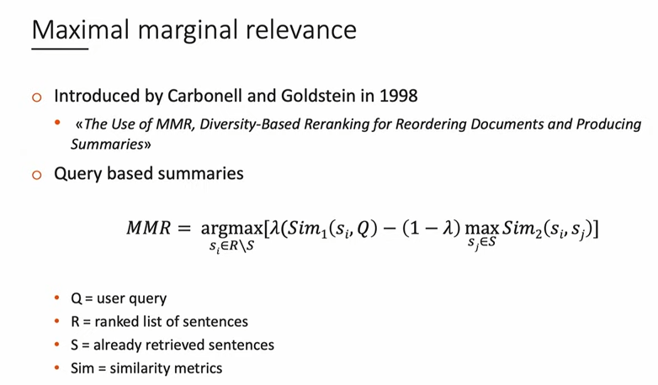
Query based Summarization

Slide 18
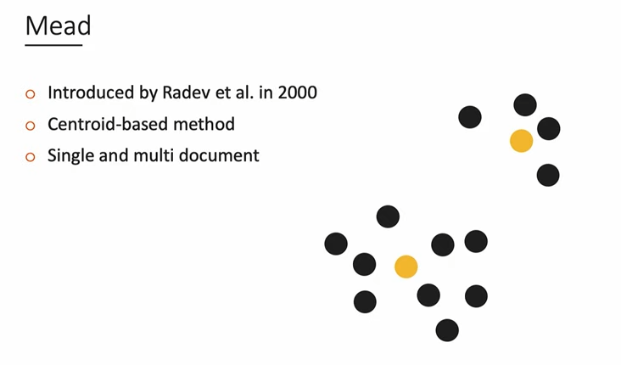

Slide 20
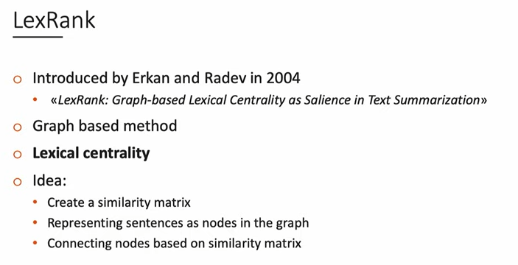
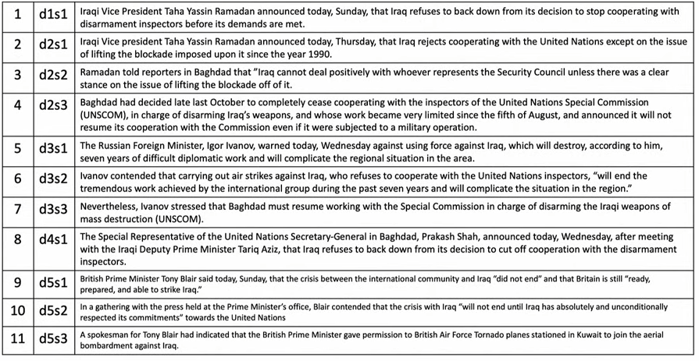
Graph Based Approaches

Slide 21
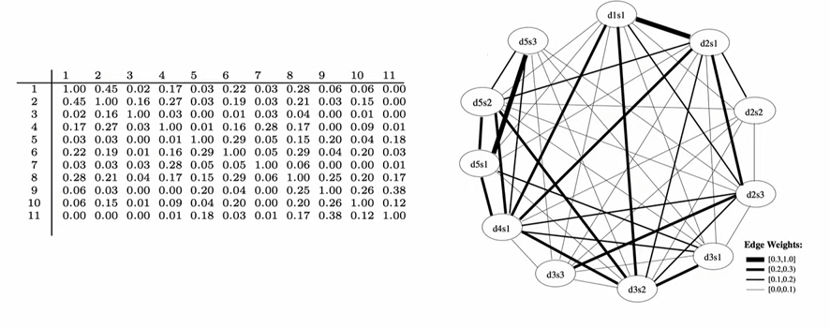
Graph Based Approaches

Slide 22
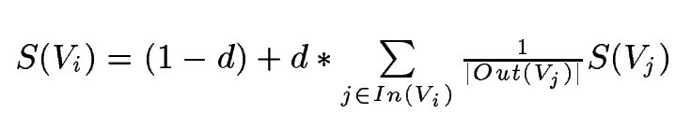
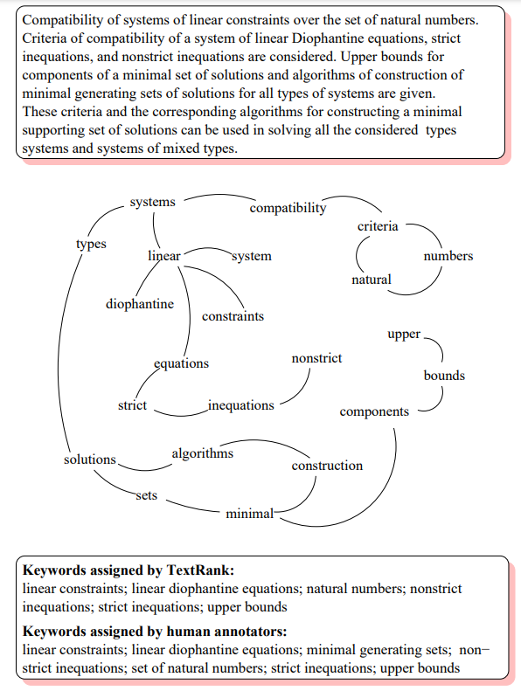
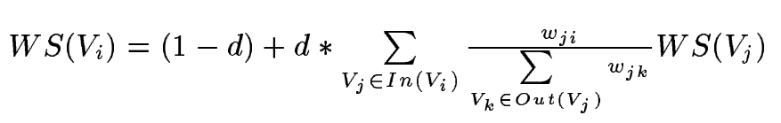
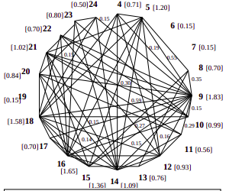
Graph Based Approaches
TextRank (Pytextrank)
Motivated by google pagerank
Document as a graph
Extracting Keywords/keyphrases
Sentence extraction task

Slide 23
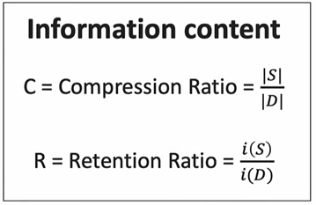
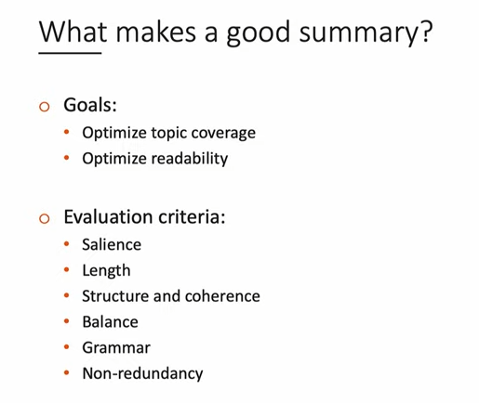
Evaluation
we want to optimize this information content basically what we want is to optimize the compression and retention ratio.
where compression ratio is just telling us okay what is the percentage of the original document that ended up in the summary and
retention ratio is telling us okay what is the percentage of information of the original document that was preserved in the summary

Slide 24
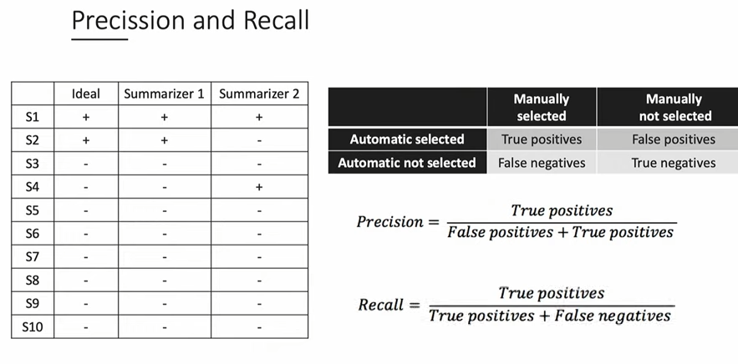

Slide 25
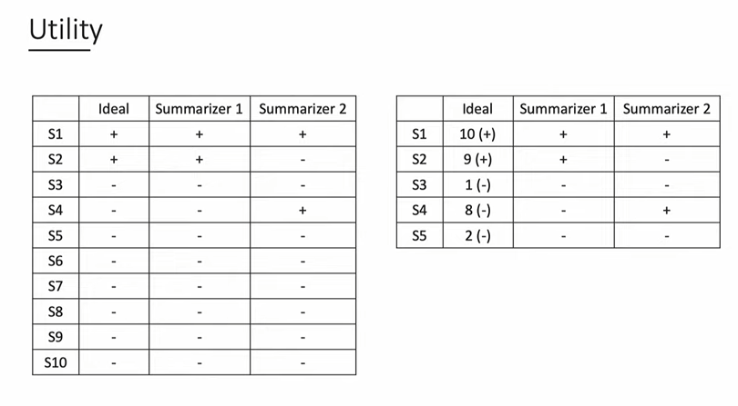
Based on ranking of the sentences

Slide 26
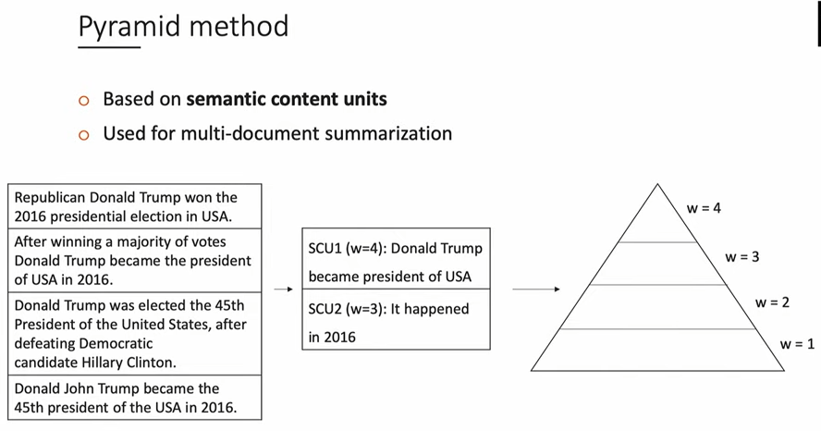
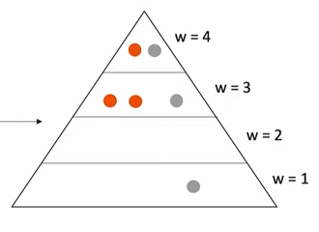

Slide 27
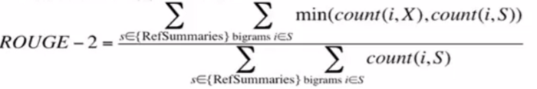
Evaluation
ROUGE: ROUGE stands for Recall-Oriented Understudy for Gisting Evaluation.
ROUGE-n
ROUGE-L
ROUGE-SU:

Slide 28
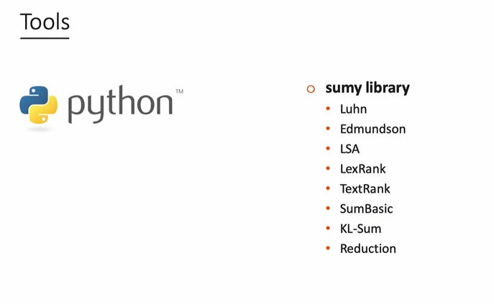
Summary of Summarizers

